Slide 1
Upload Guide
Iranian Conference on Biomedical Engineering
http://icbme.ir/
Contact us:
icbme2021@icbme.ir

Slide 2
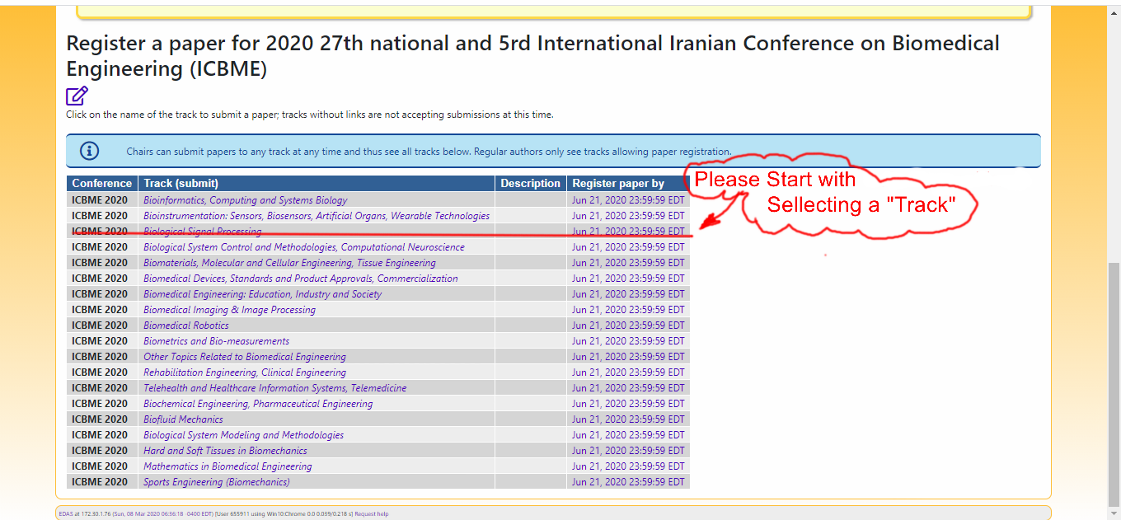
By clicking on the conference link (https://edas.info/N27003), you will see this page. Please choose the track that is the nearest to your paper category. (Note that all the mentioned date and time are in EDT time zone.)

Slide 3
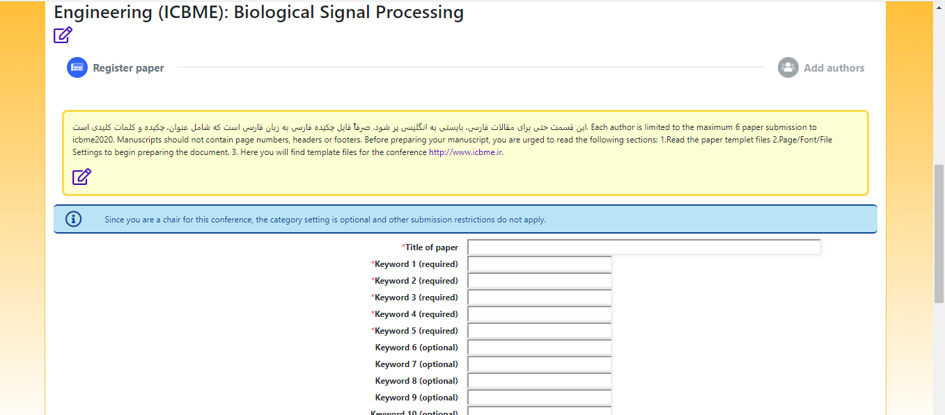
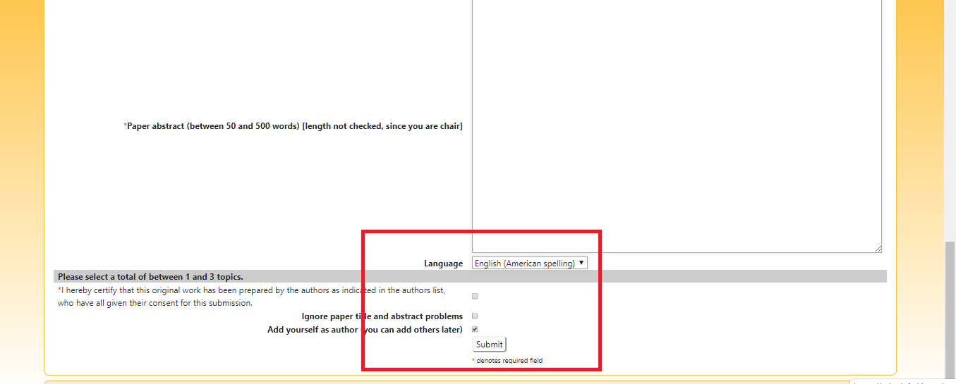
In the next page you should enter your paper information.

Slide 4
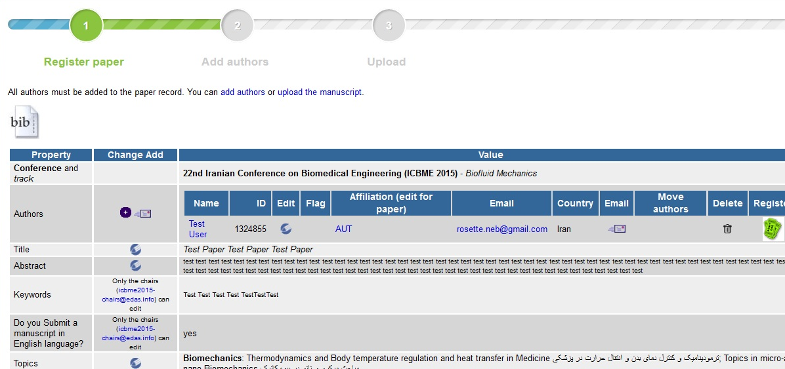
Please add all authors’ names as shown in the picture below. Every mistake at this level will affect the review process of your paper.

Slide 5
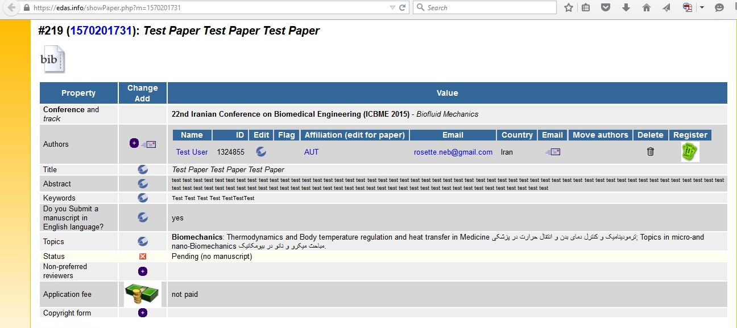
Your paper is submitted. The first status is pending. When you paid the application fee, send an email to the conference containing the payment information, and wait until your paper status changes to active. Then you will be able to upload your manuscript.

Slide 6
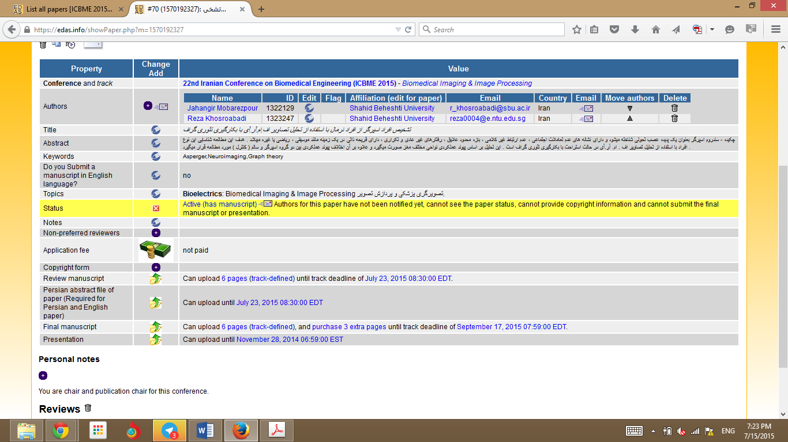
Please use the specified box for uploading your paper’s abstract and manuscript.

Slide 7
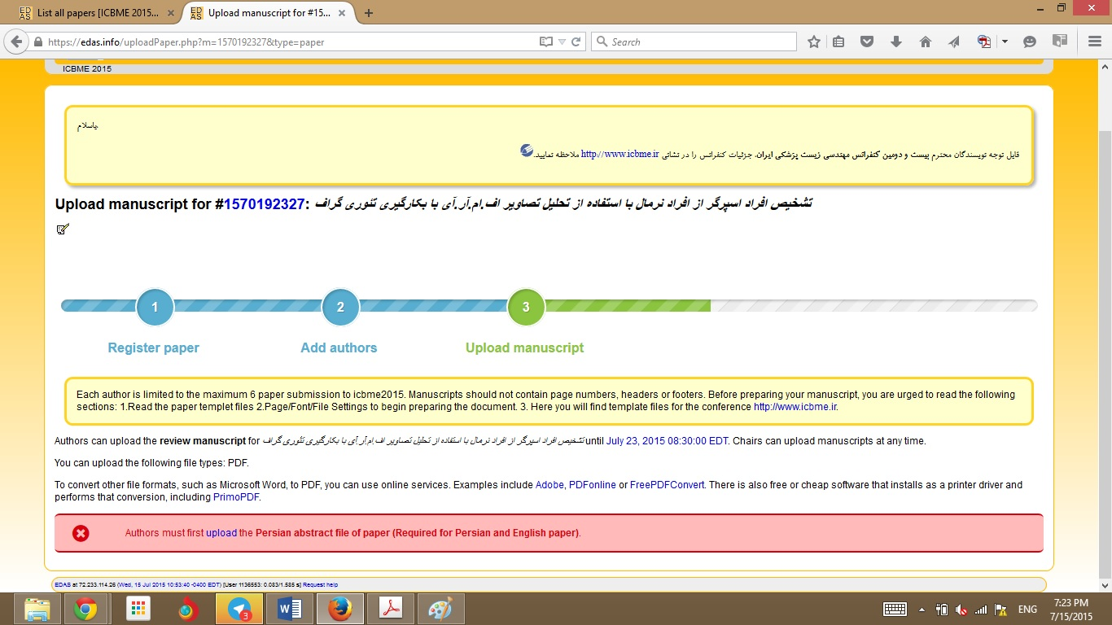
Here the system asks you to upload your paper’s Persian abstract that is used in conference bilingual booklet. Please upload your English abstract, we will translate that later.

Slide 8
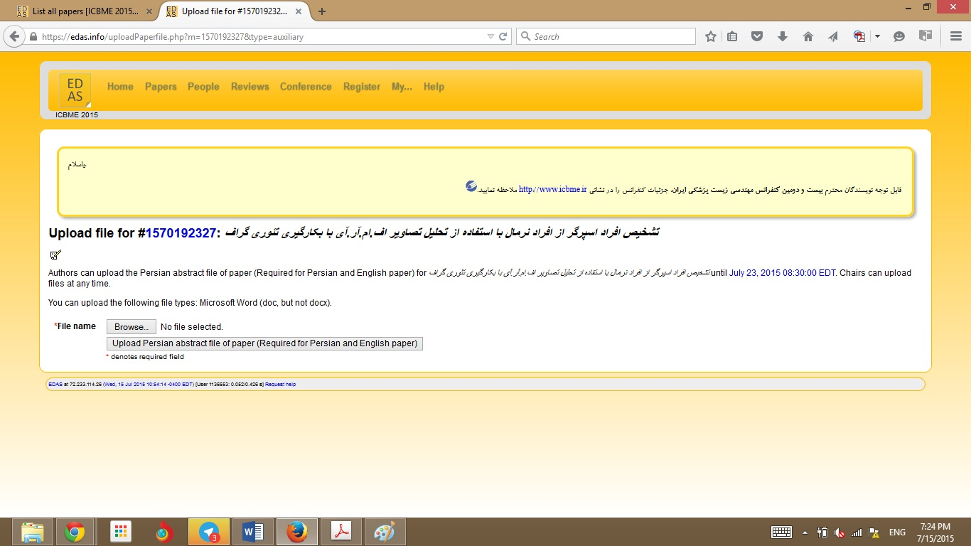
The abstract should be in “.doc” format (microsoft word 97-2003).

Slide 9
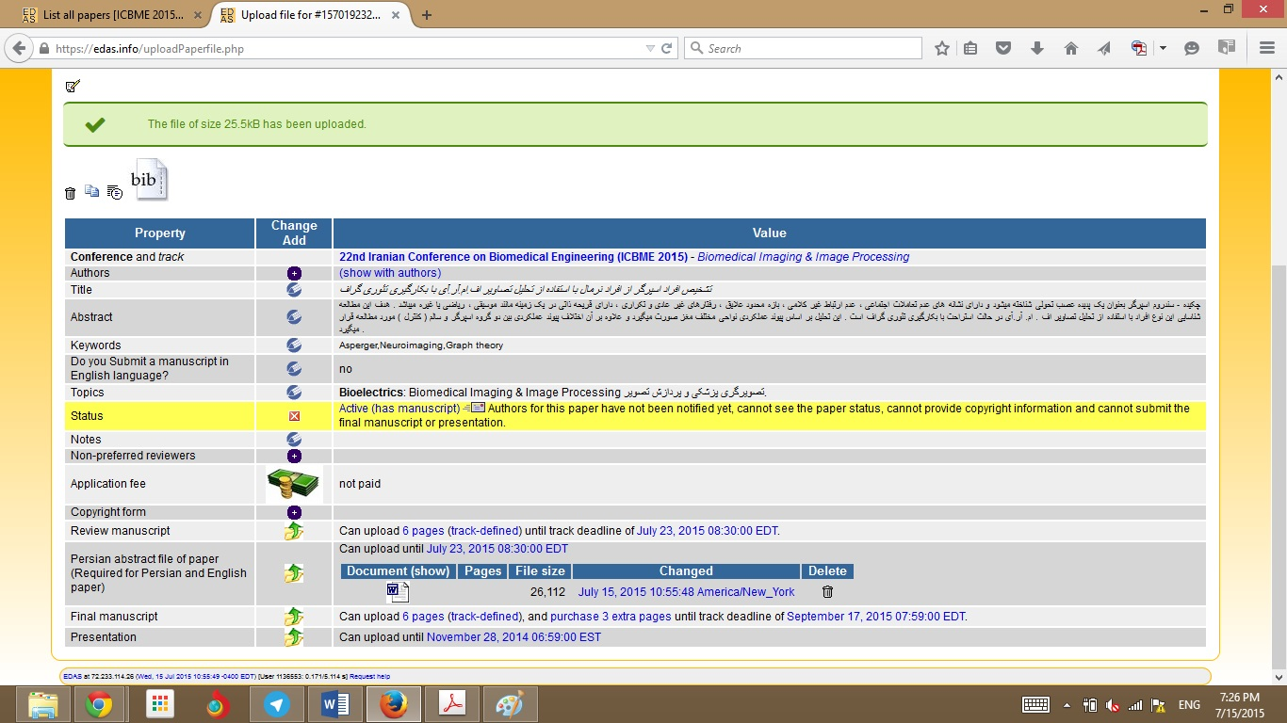
Then there will be a massage that say’s the upload has been done. In the next step you should upload the manuscript using the same upload link

Slide 10
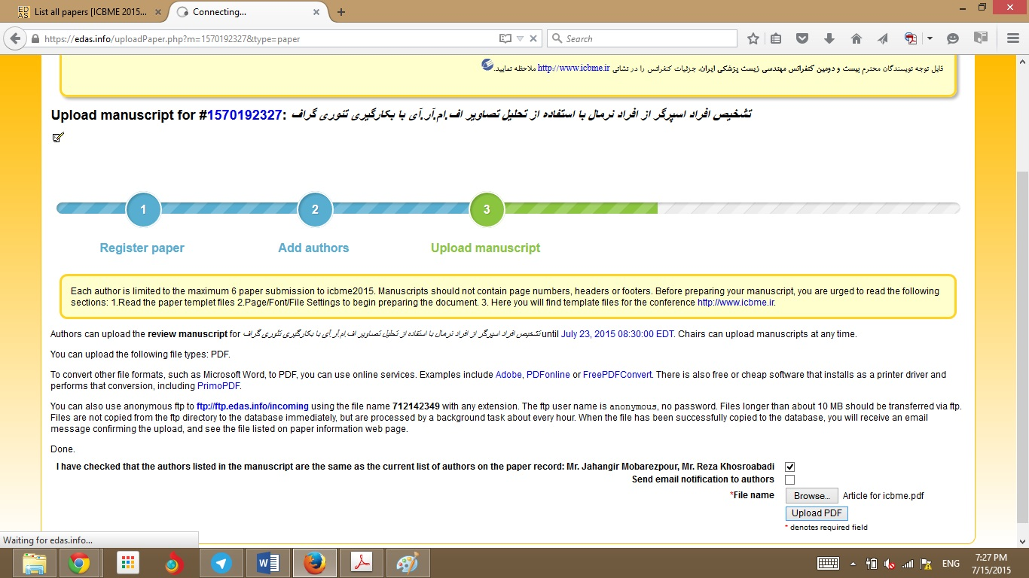
Here you can choose manuscript file and upload it. It should be a pdf file.

Slide 11
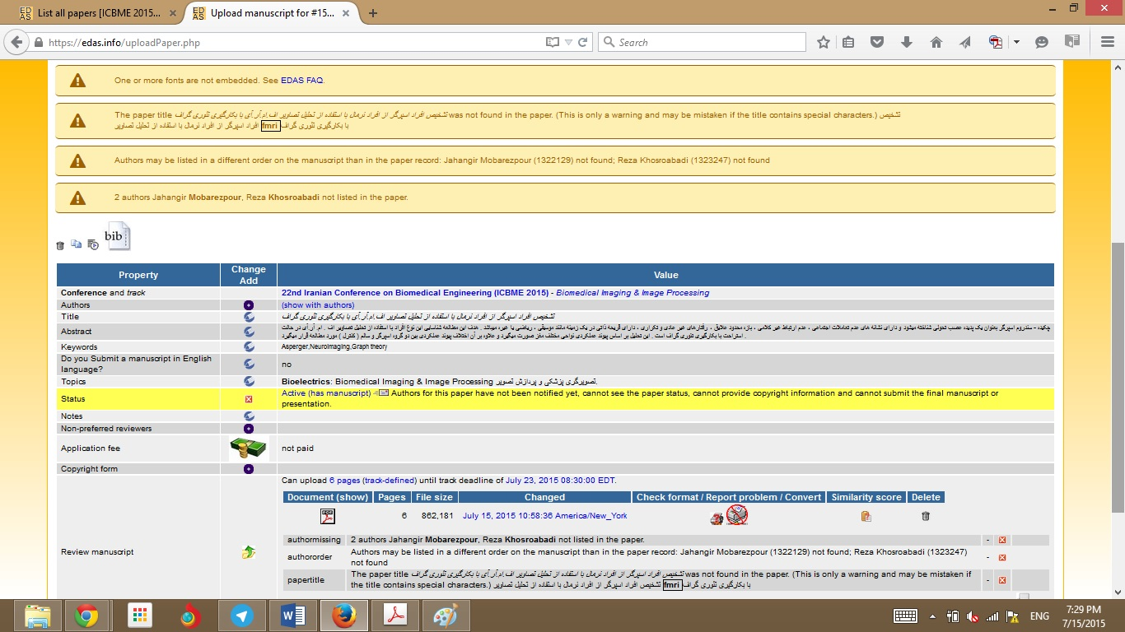
If there was any problem, you will see the errors. Please try to fix them and if you had a question contact us (an easy way to embed fonts in pdf is attached to this file).

Slide 12
Iranian Conference on Biomedical Engineering
http://ww.icbme.ir/
Contact us:
icbme2021@icbme.ir

